Slide 1

Big Data is a Big Deal!

Slide 2




Our Team
SUSHANT AHUJA
Project Lead
Algorithm Design Lead
CASSIO CRISTOVAO
Technical Lead
Website Architect
SAMEEP MOHTA
Documentation Lead
Testing Lead

Slide 3
Contents
1. Project Overview
  Project Background
  Our Goal
  Project Goals
  Project Technologies
2. Apache Hadoop and Spark
  Apache Hadoop
  Apache Spark
  Difference between Hadoop and Spark
  Cluster
  Multiple Reducer Problem
3. Benchmarks
4. Iteration Description
  Iteration 1
  Iteration 2
  Iteration 3 & 4
  Schedule

Slide 4
Section 1:
Project Overview

Slide 5
Project Background
Big Data Revolution
  Phones, tablets, Laptops, Computers
  Credit Cards
  Transport Systems
  0.5 % of data stored is actually analyzed¹
Smart Data (Data Mining and visualization of Big data)
  Recommendation Systems
    Netflix, Amazon, Facebook
    1. Source: http://www.forbes.com/sites/bernardmarr/2015/09/30/big-data-20-mind-boggling-facts-everyone-must-read/#ec996f46c1d3

Slide 6
Our Goal
(Problems we are solving)
Gathering Research data for validation
  Performance tests in different environments
Predict (data mining) data through recommendation systems
Improve the knowledge and awareness on Big Data at TCU Computer Science Department

Slide 7
Project Goals
Compare efficiency of 3 different environments
Validate the Feasibility
Transform structured query process into non-structured Map/Reduce tasks
Report performance statistics
  Single Node (Java, Hadoop & Spark environments)
  Cluster (Hadoop & Spark environments)
Turning ‘Big Data’ into ‘Smart Data’
  Build recommendation system

Slide 8
Project Technologies
Java Virtual Machine
Eclipse IDE
Apache Hadoop
Apache Spark
Maven in Eclipse for Hadoop and Spark
Mahout on Hadoop systems
MLlib on Spark systems

Slide 9
Section 2:
Apache Hadoop and Spark

Slide 10
Apache Hadoop
Born out of the need to process an avalanche of data
Open-source software framework
Was designed with a simple write-once storage infrastructure
MapReduce – relatively new style of data processing, created by Google
Become the go-to framework for large-scale, data-intensive deployments

Slide 11
Apache Hadoop
Can handle all 4 dimensions of Big Data – Volume, Velocity, Variety, and Veracity
Hadoop’s Beauty – efficiently process huge datasets in parallel
Both Structured (converted) and Unstructured
HDFS – breaks up input data, stores it on compute nodes (parallel processing) – blocks of data

Slide 12
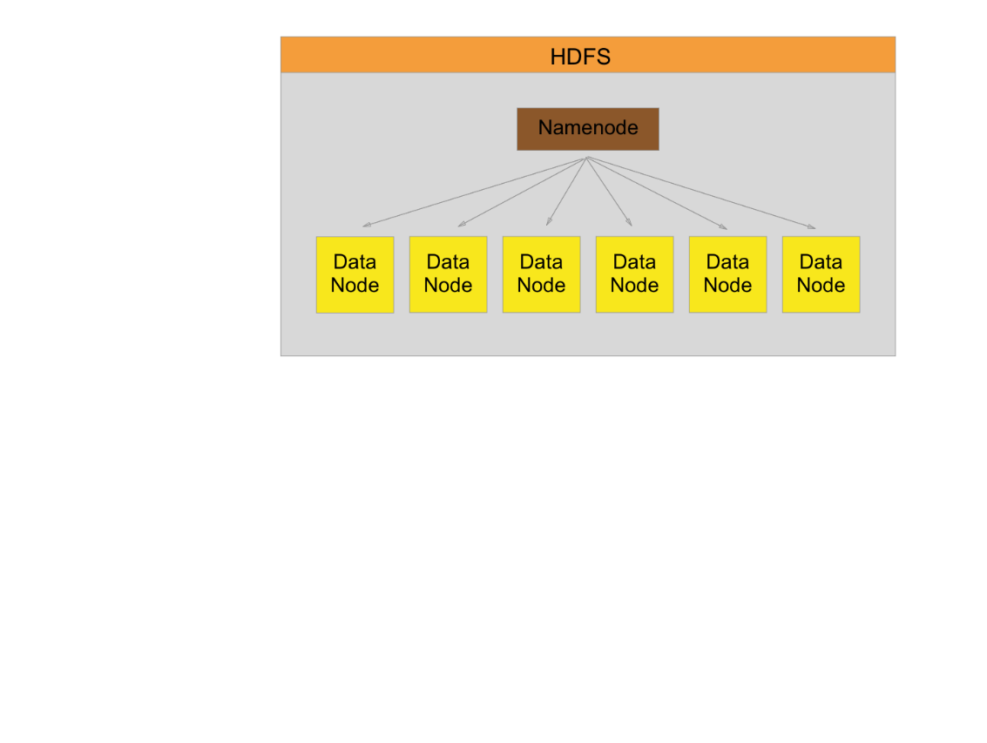
HDFS Segmentation

Slide 13
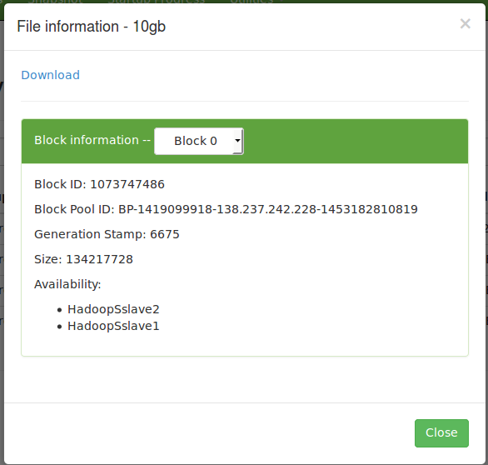
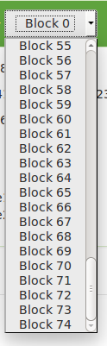

Slide 14
Hadoop Map/Reduce
Map Phase:
  Splits input data-set into independent chunks
  Processed in parallel manner – map tasks
  Framework sorts the output of map tasks
Reduce Phase:
  Takes input from map function
  Performs summary operation
  Output stored in HDFS

Slide 15
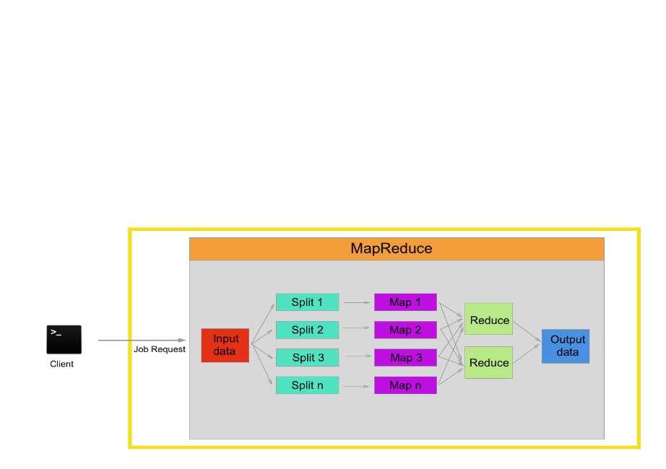
Hadoop Map/Reduce

Slide 16
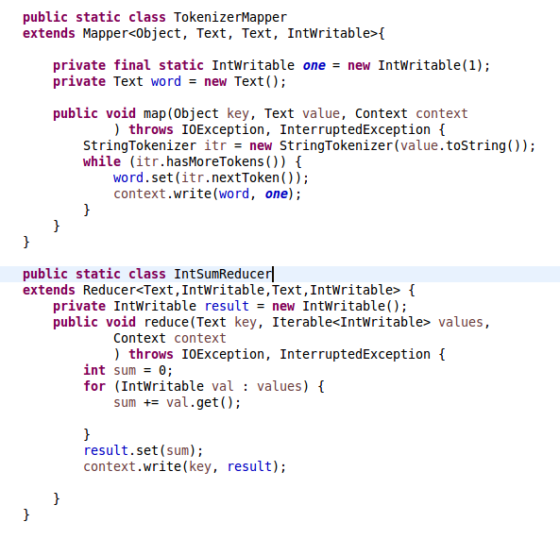

Code Snippet of Word Count
Output
Input

Slide 17
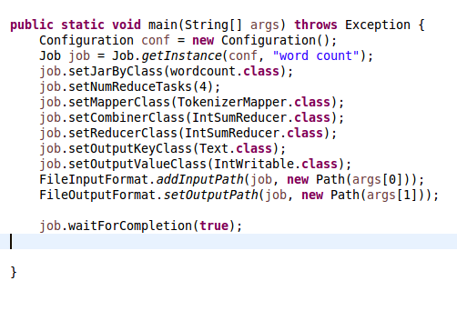
Code Snippet of Word Count

Slide 18
Apache Spark
Open source big data processing framework designed to be fast and general-purpose
Fast and meant to be ease to use
Originally developed at UC Berkeley in 2009

Slide 19
Apache Spark
Supports Map and Reduce functions
Lazy evaluation
In-memory storage and computing
Offers APIs in Scala, Java, Python, R, SQL
Built-in libraries; Spark SQL, Spark Streaming, MLlib, GraphX

Slide 20
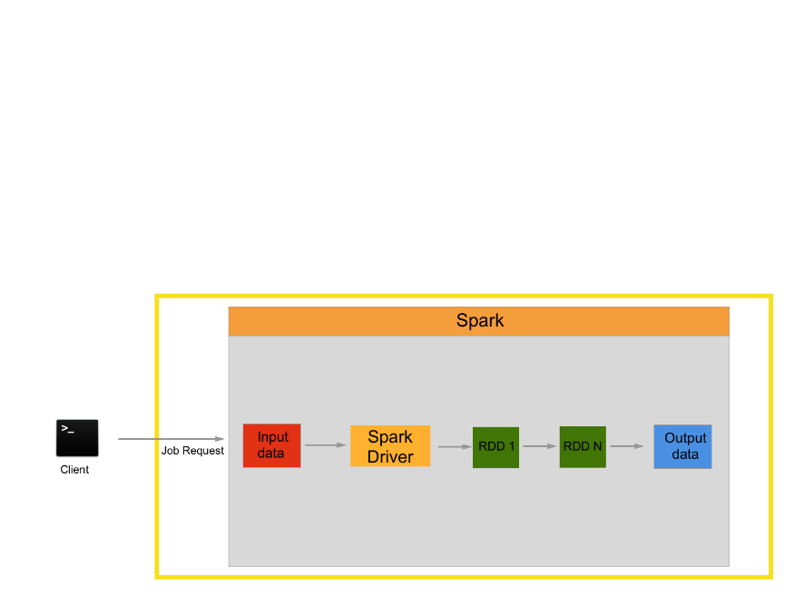
Apache Spark

Slide 21
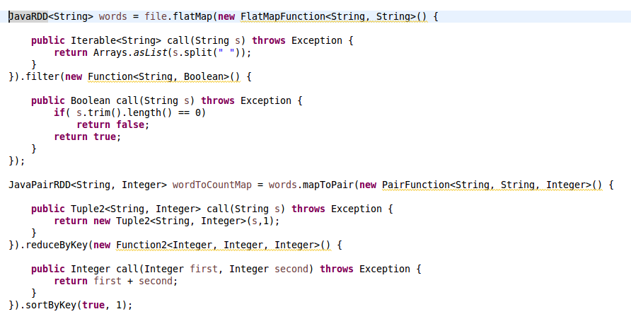
Code Snippet of Word count

Slide 22
Code Snippet of Word count

Slide 23
Difference Between Hadoop and Spark
Not mutually exclusive
Spark – does not have its own distributed system, can use HDFS or others
Spark – Faster as works “in memory”, Hadoop works in Hard drive
Hadoop – needs a third-party machine-learning library (Apache Mahout), Spark has its own (MLlib)
Not really a competition as both are non-commercial, open-source

Slide 24
Cluster

Slide 25
Hadoop and Spark Cluster
One manager node with two worker nodes, all with same configuration
Namenode on manager, Datanode on workers
No data stored on the manager

Slide 26
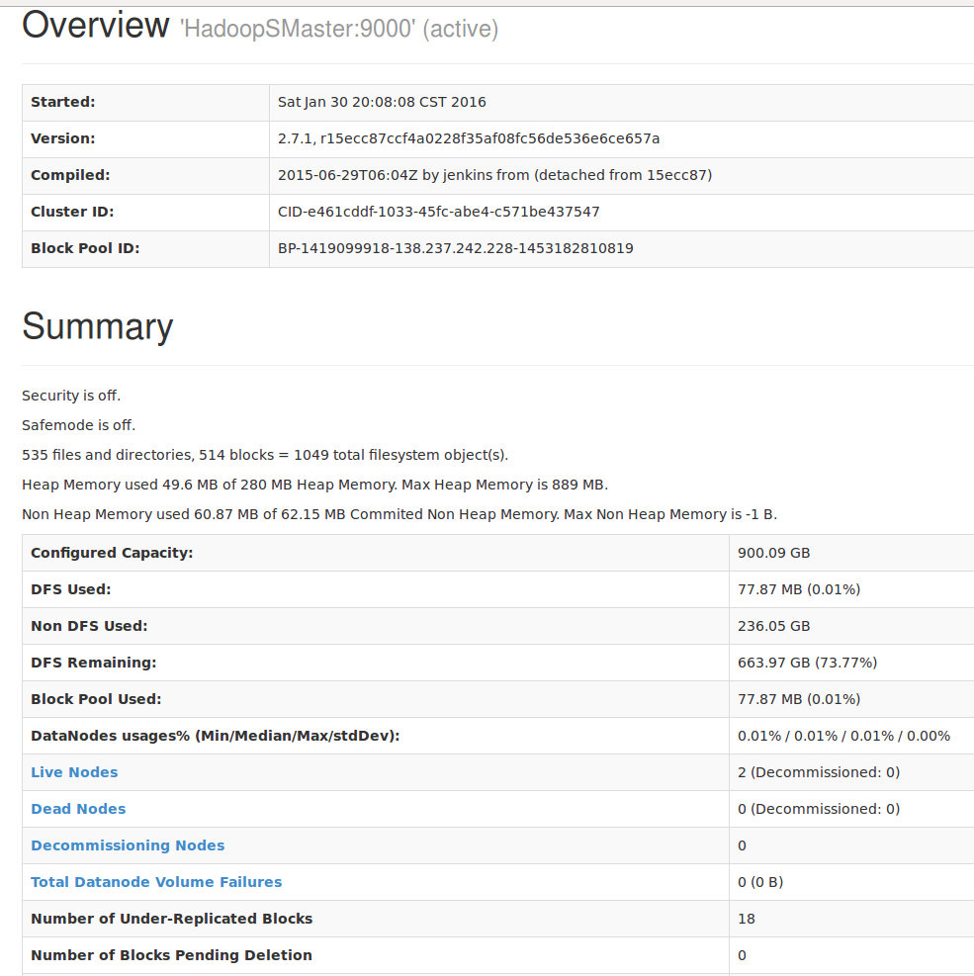

M
W
W

Slide 27
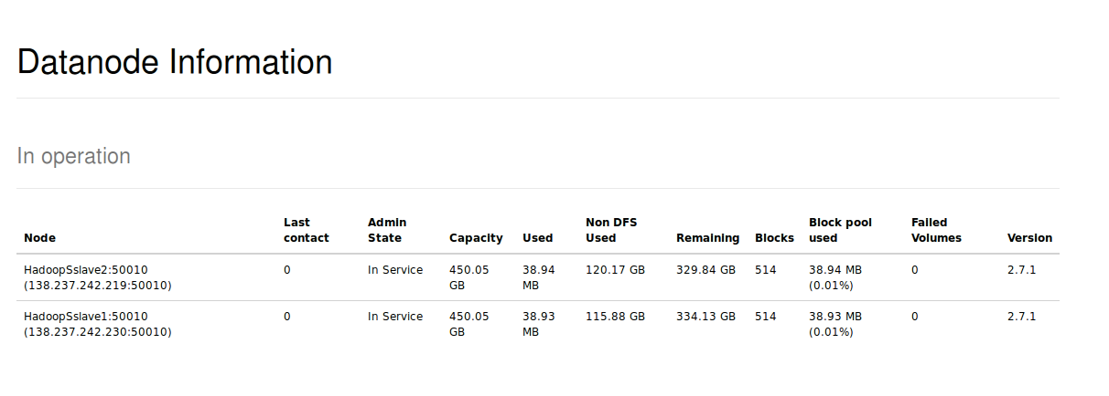
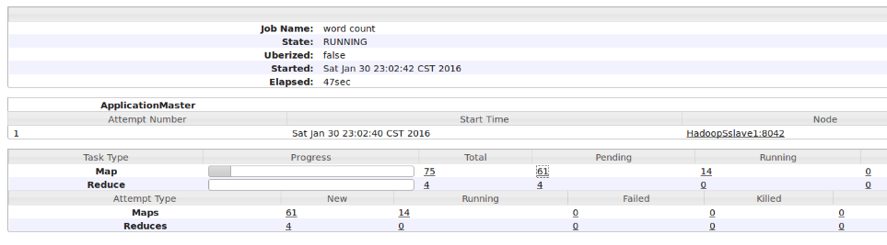
M
W
W

Slide 28
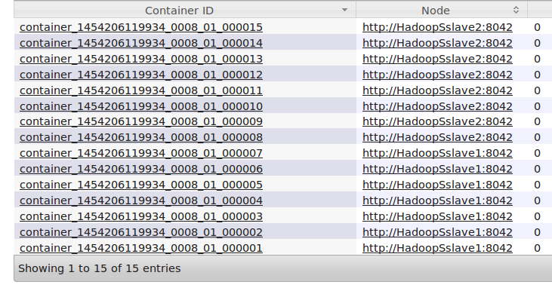
Container Allocation
Input File
B1
Container 1
B2
Worker 1
B3
B4
Container 2
Worker 2
B5

Slide 29
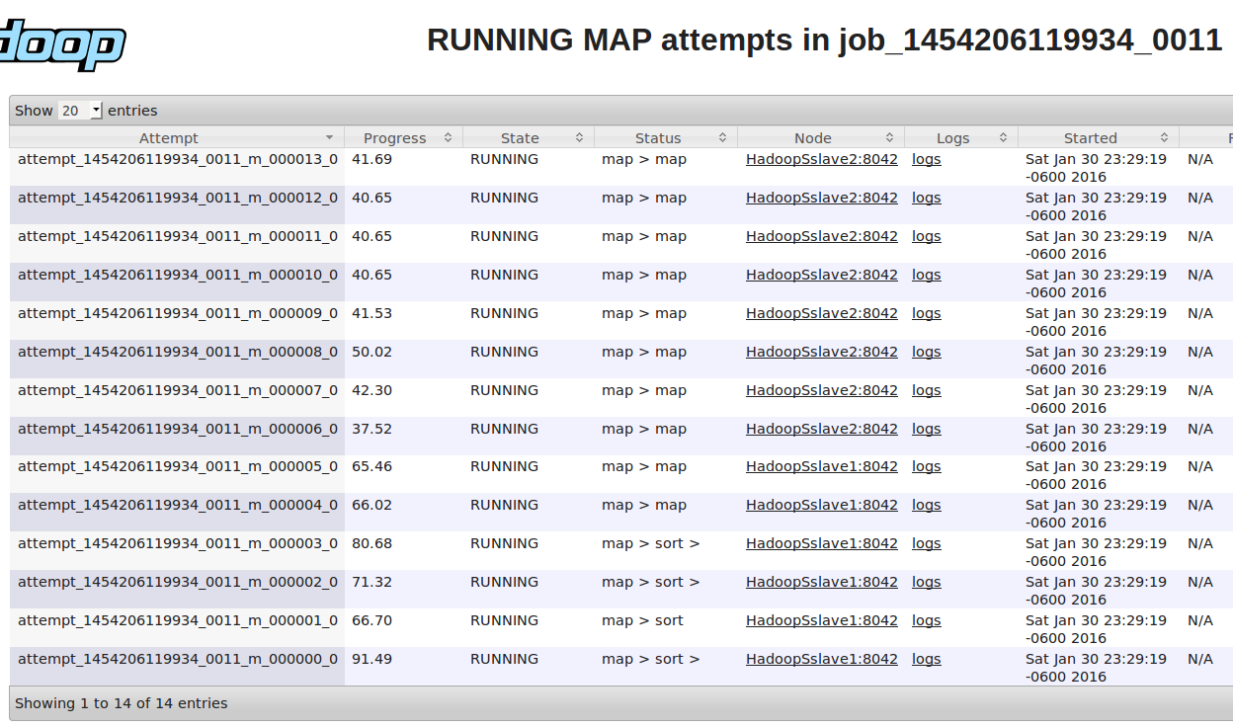
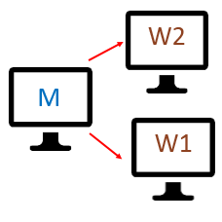
Map Tasks

Slide 30
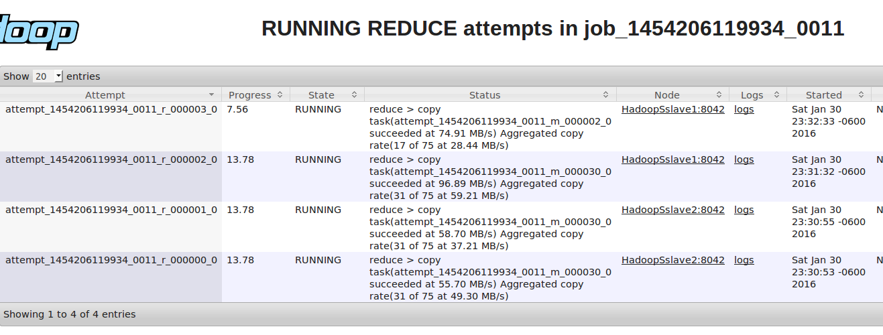
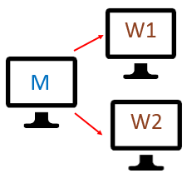
Reduce Tasks

Slide 31
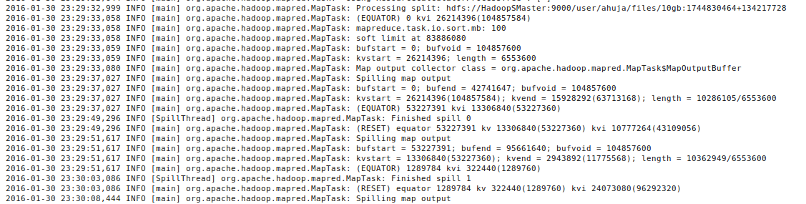
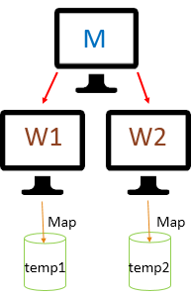
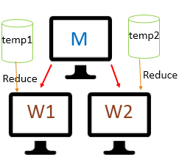
Map/Reduce Log

Slide 32
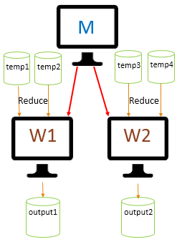
Multiple Reducer Problem
Problem : Multiple Output files with multiple reducers.
Ideally, only one output file.
Solution : Map/Reduce Job Chaining.
Map1 -> Reduce1 -> Map2 -> Reduce2

Slide 33
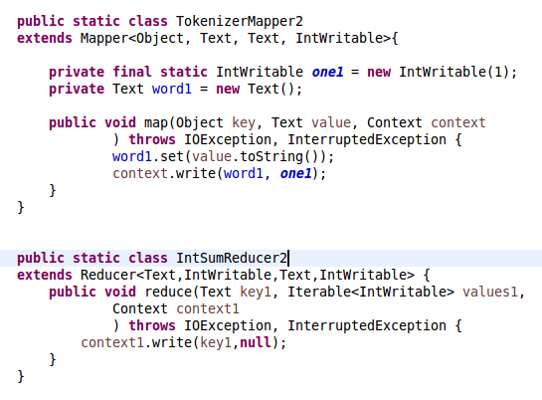
Map/Reduce for Job-2

Slide 34
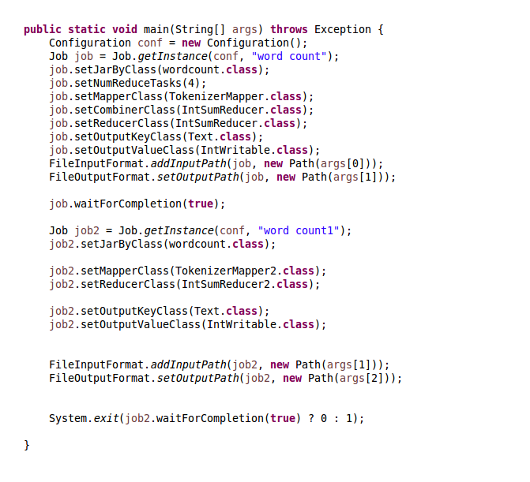
Job Chaining

Slide 35


Job Chaining
Map
Map
Job - 1
temp3
temp4
Job - 2
Reduce
Reduce
Reduce
Reduce
Output
File

Slide 36
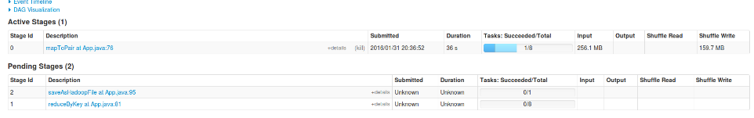

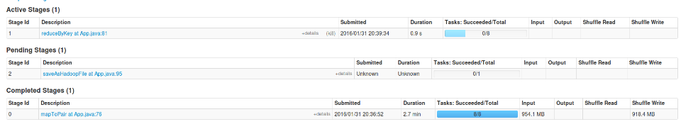
Spark Job
Input 1
Input 2
Map 1
Map 2
Reduce
Reduce
output1
Notes:
Instead of disk icon, use heap icon

Slide 37
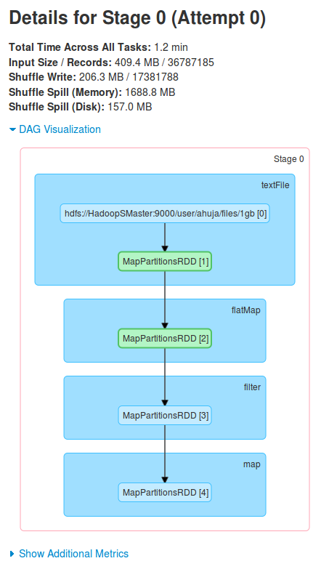
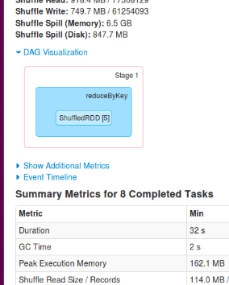
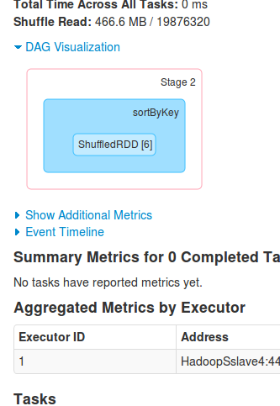
Stage 1
Stage 2
Stage 3
Map 1
Reduce 2
Save 1
Input 1
Output 1

Slide 38
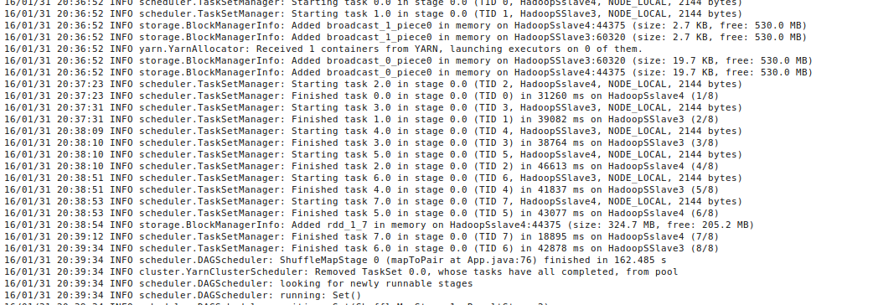

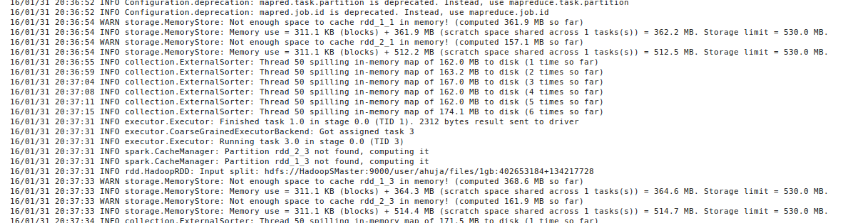
Spark Log
Input 1
Input 2
Map 1
Map 2
Reduce
output1

Slide 39
Benchmarks

Slide 40
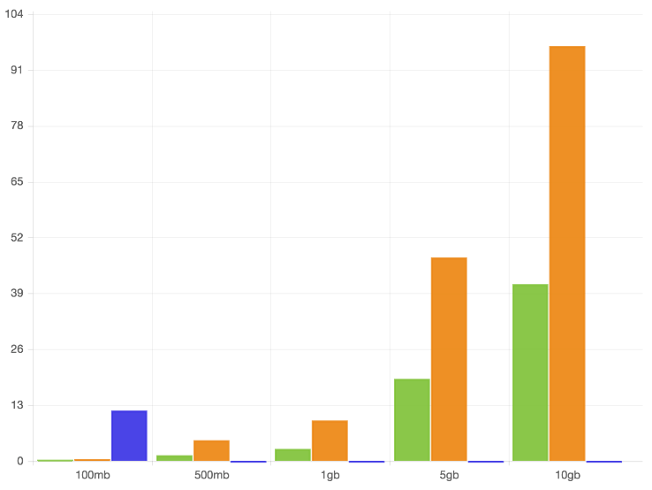
Word Count (Single-Node)
Spark
Hadoop
Java
Time (in minutes)
Size of the text file
Notes:
Java Stoppage point indication

Slide 41
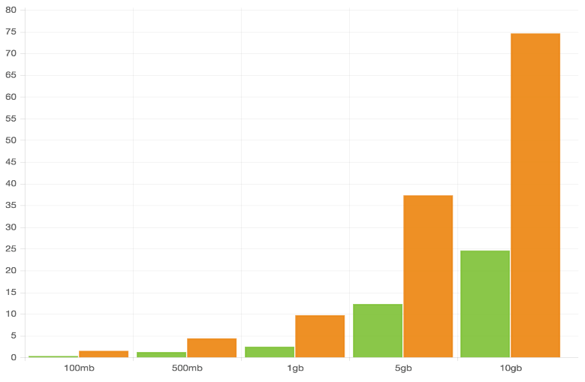
Word Count (Cluster)
Spark
Hadoop
Time (in minutes)
Size of the text file

Slide 42
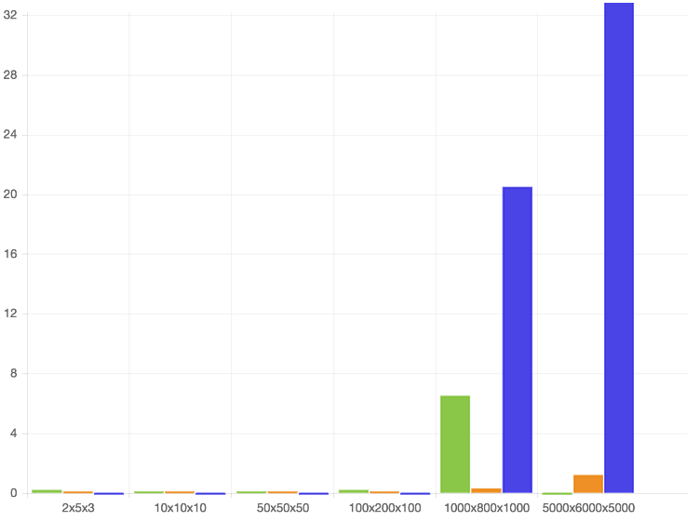
Matrix-Multiply (Single-Node)
Spark
Hadoop
Java
Time (in minutes)
Size of the Matrices
Notes:
Java Graph as well

Slide 43
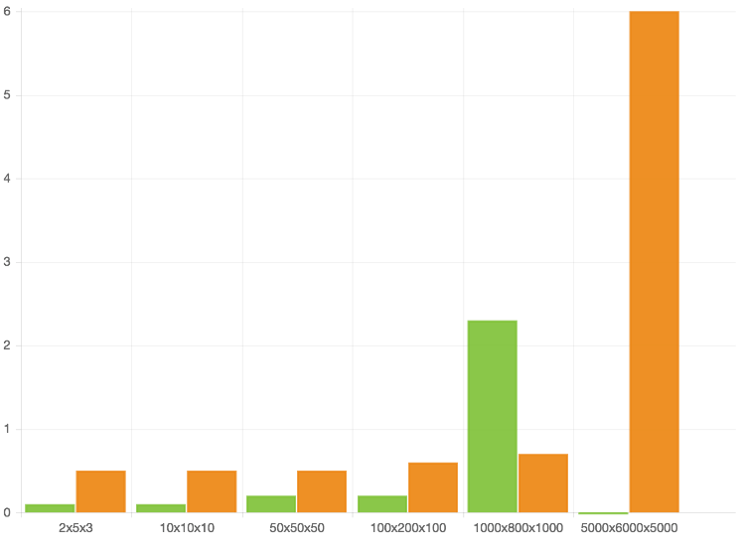
Matrix-Multiply (Cluster)
Spark
Hadoop
Time (in minutes)
Size of the Matrices

Slide 44
Section 3:
Iteration Description

Slide 45
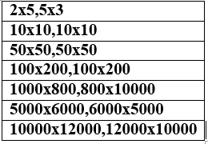
Iteration 1
Setting up 6 Linux machines
  Hadoop and Spark on 2 machines as master nodes
  2 slave nodes for Hadoop and Spark each
Initial Software Tests
  Word Frequency Count on all the 3 environments with text files of different sizes (10mb, 50mb, 100mb, 500mb, 1gb, 5gb and 10gb)
  Large Matrix Multiplication
    with the following matrix sizes:

Slide 46
Iteration 2
Setting up a cluster with at least 2 slave nodes.
Running Mahout on Hadoop systems and Mlib on spark systems
Start building a Simple Recommender using Apache Mahout

Slide 47
Iteration 3 & 4
Iteration 3:
  Using K-means clustering on all 3 machines
  Perform unstructured text processing search on all 3 machines
  Perform classification on both the clusters
Iteration 4:
  Using K-means clustering to create recommendation systems from large datasets on all 3 machines

Slide 48
Schedule
  Skeleton Website 4 October, 2015
  Software Engineering Presentation 15 December, 2015
  Iteration 1 15 December, 2015
  Project Plan v2.0 21 January, 2016
  Requirements Document v2.0 21 January, 2016
  Design Document v2.0 21 January, 2016
  Iteration 2 2 February, 2016
  Faculty Presentation 2 February, 2016
  Iteration 3 3 March, 2016
  Iteration 4 31 March, 2016
  User manual 5 April, 2016
  Developer manual 7 April, 2016
  SRS 8 April, 2016
  NTASC Presentation 16 April, 2016
  Complete Documentation 26 April, 2016
  Final Presentation 28 April, 2016

